Slide 1

CSET211: Statistical Machine Learning Project Submitted by: 1) Abhinay Sumant Singh (E23CSEU2273) 2) Paramdeep Singh (E23CSEU2252) 3) Abhisekh Nallapati (E23CSEU2262) Submitted to: Dr. Shakshi Sharma
Project Title
GEOPRED

Slide 2
Contents
S.no. | Contents | Slide no.
1 | Introduction | 1
2 | Problem Statement | 2
3 | Dataset Overview | 3
4 | Methodology Overview | 4
5 | ARIMA Model Explanation | 5
6 | Preprocessing Details | 6
7 | Results and Evaluation | 7
8 | Web Deployment | 8 – 9
9 | Challenges Faced | 10
10 | Future Scopes | 11
11 | Conclusion | 12

Slide 3
What is the project about? This project focuses on predicting population and GDP trends using ARIMA models. Time series forecasting enables us to analyze historical data and generate short-term future predictions for strategic planning. Why is it important? Accurate population and GDP forecasts are crucial for economic planning, policy-making, and resource allocation. Goals: 1. Build models for predicting key trends in population and GDP. 2. Deploy the results on a web application for accessibility and interactivity.
Introduction

Slide 4
Problem Statement
Challenges in Forecasting:
Handling Incomplete and Inconsistent Datasets
Capturing Complex Trends and Seasonal Patterns
Short Historical Data Availability
Balancing Simplicity and Accuracy
Objective:
Develop Predictive Models for Population and GDP
Analyze Trends Using ARIMA
Deploy Interactive Web Application
Provide Actionable Insights for Decision-Making

Slide 5
Dataset Overview
Sources:
Population and GDP datasets covering multiple countries from 2000 to 2023 and 1990 to 2023 respectively.
Attributes:
Population: Annual population numbers for each country.
GDP: Annual GDP values (current US$) for each country.
Data Cleaning:
Removed years with incomplete data (e.g., 1990, 2000).
Replaced missing values using linear interpolation and forward/backward filling. Visual: Include a sample table or graph showing raw data.

Slide 6
Methodology Overview
Preprocessing:
Address missing values and ensure data consistency.
Transform data into time series format with years as indices.
Model Training:
Fit ARIMA models to population and GDP data.
Split datasets into training and testing based on predefined years (2018 and 2020).
Evaluation:
Use RMSE to validate predictions against actual test data.
Deployment:
Design a web application using HTML, CSS, and JavaScript. Visual: Flowchart summarizing the process.

Slide 7

ARIMA Model Explanation
What is ARIMA?
Auto-Regressive Integrated Moving Average, a statistical model for analyzing time series data.
Key Parameters:
(p, d, q): Non-seasonal components.
(P, D, Q, m): Seasonal components for SARIMA.
Why ARIMA?
Ideal for small datasets.
Interpretable and robust for short-term forecasting.

Slide 8
Preprocessing Details
Steps Taken:
Removed incomplete years (e.g., 1990, 2000).
Handled missing values:
Linear interpolation for filling gaps.
Forward/backward filling for edge cases.
Ensured stationarity:
Differenced the series as required for ARIMA models.

Slide 9


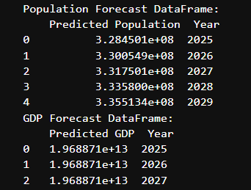
Results and Evaluation
Predictions:
Population: Forecasted for the next 5 years (2025–2029).
GDP: Forecasted for the next 3 years (2025–2027).

Slide 10
Web Deployment
Tools Used:
Front-End: HTML, CSS, JavaScript for creating a responsive user interface.
Back-End: Flask for processing requests and serving predictions.
Deployment Architecture:
Input Handling:
Users input country names on the front-end.
Back-end validates and standardizes input (e.g., "USA" → "United States").
Data Processing:
Retrieves and preprocesses data for selected countries.
Handles missing values dynamically.
Model Execution:
Trains ARIMA models and generates predictions.
API Integration:
/predict endpoint processes requests and returns predictions in JSON format.

Slide 11
Web Deployment
Current Deployment:
Local Server: Flask app tested locally with debug mode enabled.
Future Deployment Plans:
Deploy on cloud platforms like Heroku, AWS, or Google Cloud.
Use Docker for containerized deployment.
Features of the Web Application:
Validates user inputs and displays predictions interactively.
Logs server-side requests for debugging.
Outputs are rounded and formatted for user readability.

Slide 12
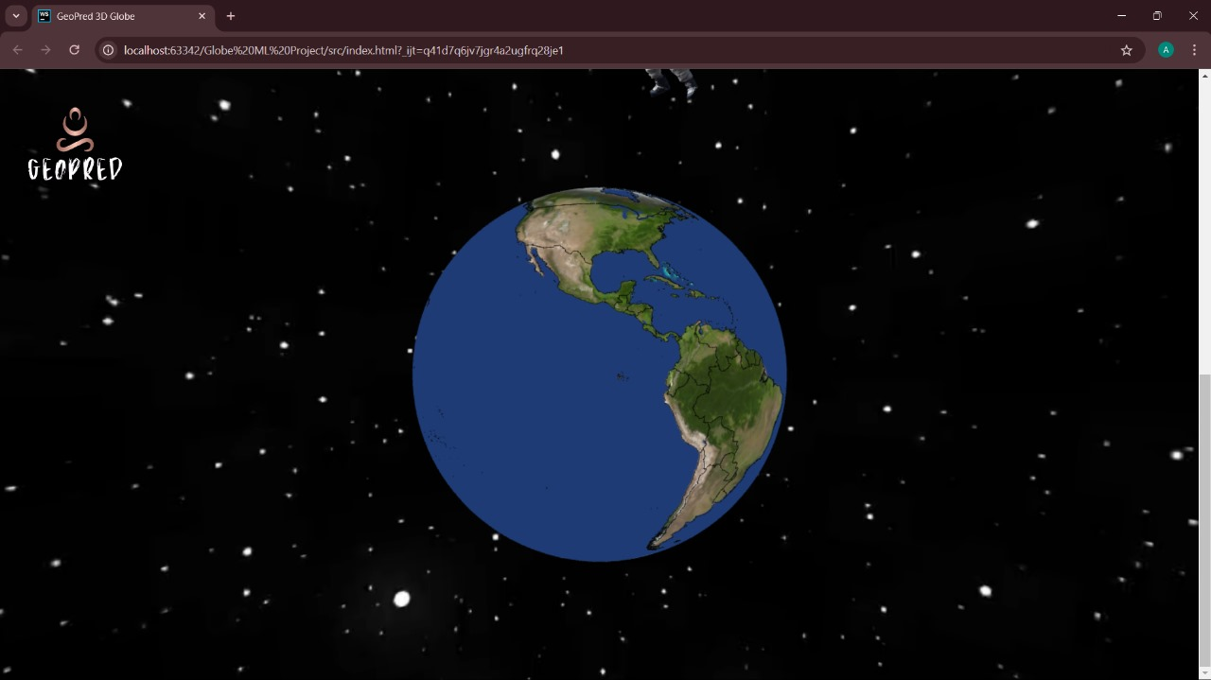

Slide 13
Challenges Faced
Data Challenges:
Missing values and non-standardized formats.
Modeling Challenges:
Short time series limits model effectiveness.
Identifying optimal ARIMA parameters.
Deployment Challenges:
Ensuring seamless communication between front-end and back-end.
Handling variations in user input.

Slide 14
Future Scope
Data Improvements:
Add external predictors (e.g., inflation rates, trade data).
Expand the dataset to include more historical years.
Model Enhancements:
Implement hybrid models combining ARIMA with machine learning techniques.
Web Application:
Deploy globally with real-time data updates.
Add user accounts for customized predictions.

Slide 15
Conclusion
Key Achievements:
Developed ARIMA-based models for population and GDP forecasting.
Deployed an interactive web application to visualize predictions.
Significance:
Provides actionable insights for decision-making in economic and demographic planning.

Slide 16

Thank you

